Slide 1
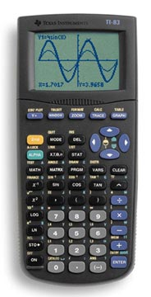

Introduction to programming in MATLAB
MATLAB can be thought of as an super-powerful graphing calculator
    Remember the TI-83 from calculus?
    With many more buttons (built-in functions)
In addition it is a programming language
MATLAB is an expression or interpreted language
    Commands executed line by line

Slide 2
Outline
Basics – The MATLAB Windows
Scripts
Functions
Toolboxes
  Bioinformatics
  Statistics
  Simbiology
  Parallel Computing

Slide 3
But Sir, I am a biology Major
Don’t want students spending far too much time trying to figure out why their Fortran code failed and not enough time learning about genomics.
Matlab is an interactive environment
Matlab is based on a command line where you can see and manipulate variables. You enter commands at the prompt >> and Matlab responds.
Most students would be able to pick up the basics quickly, and begin using it confidently in just a few hours.
Utility beyond the classroom.
  can use for many things other than genomics problems
  thousands of people worldwide are using MATLAB in teaching, research, and commercial applications.

Slide 4
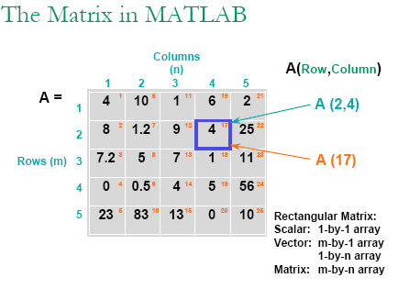
MATLAB = MATrix LABoratory

Slide 5
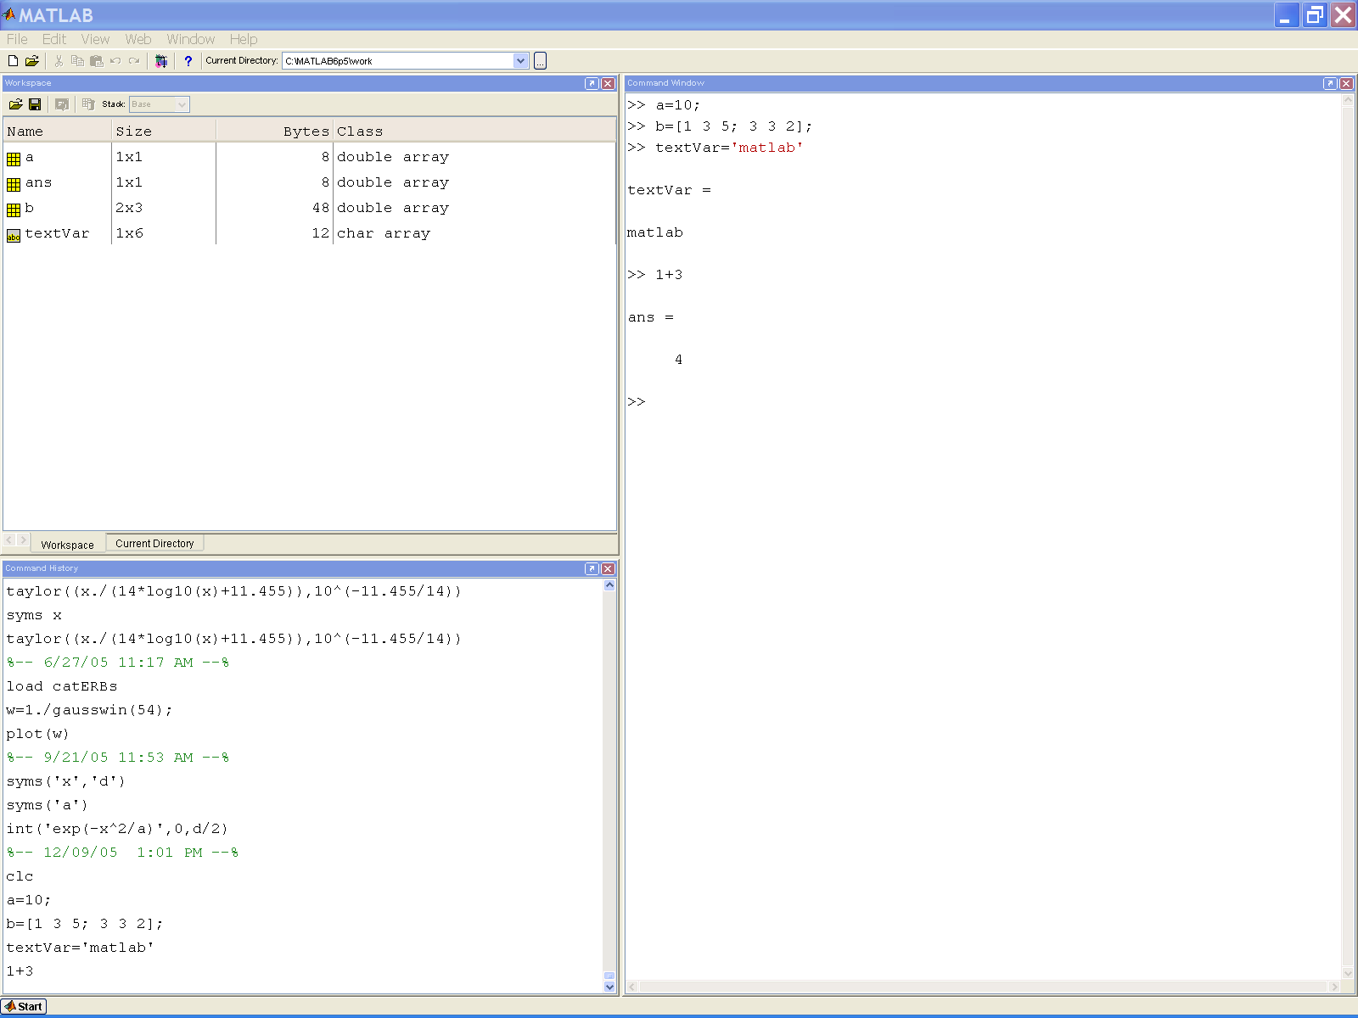
Current directory
Workspace
Command Window
Command History

Slide 6
Current directory
Workspace
Command Window
Command History

Slide 7
Docking/Undocking:
Docking/Undocking: use to add or remove windows to the MATLAB desktop

Slide 8
MATLAB Basics
MATLAB can be thought of as an super-powerful graphing calculator
    Remember the TI-83 from calculus?
    With many more buttons (built-in functions)
In addition it is a programming language
    MATLAB is an expression or interpreted language
    Commands executed line by line

Slide 9
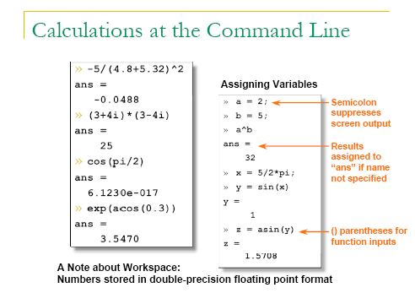
Command Window

Slide 10
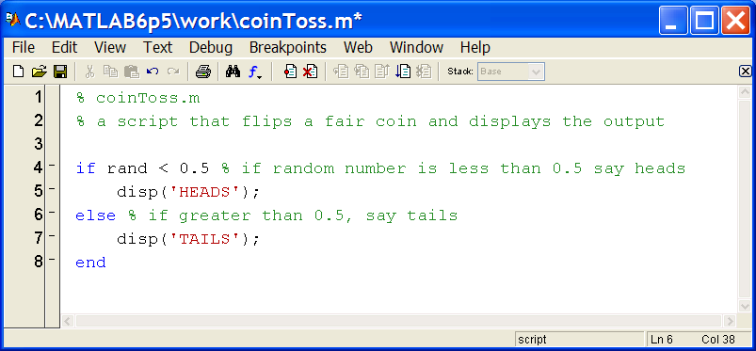
Scripts: the Editor (“.m” files)
* Means that it's not saved
Line numbers
m-file path
Debugging tools
Help file
Comments
Possible breakpoints

Slide 11
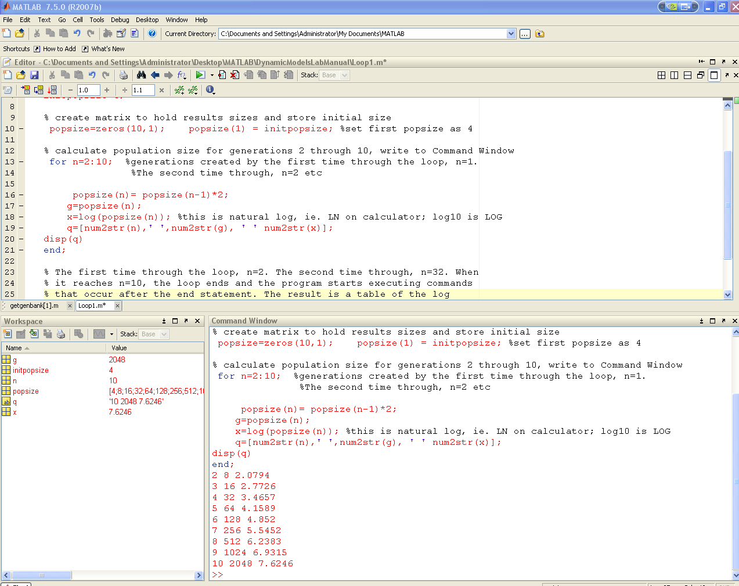
Do Your Real Work (Scripts) in The Editor, where you make .m Files

Slide 12
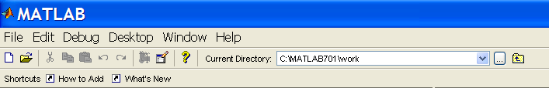
Scripts: Overview
Scripts are
    written in the Matlab editor
    saved as m-files (.m extension)
    evaluated line by line
To create an m-file from command-line
  edit myScript.m
or click

Slide 13
Scripts: Exercise 1
% This is practice script1.m:
% Let's assume a and b are the lengths of 2 sides
% of a right %triangle
%Calculate the length of the other side (the hypotenuse, c) using the Pythagorean formula: c^2=a^2 + b^2
  Assume side a=3 and side b=4

Slide 14
Why Script when can make function
% This is practice script1.m:
% Let's assume a and b are the lengths of 2 sides
% of a right %triangle
%Calculate the length of the other side (the hypotenuse, c) using the
% Pythagorean formula: c^2=a^2 + b^2
%First define 2 variables:
a = 3;
b = 4;
c = sqrt(a*a + b*b);
%and, let's see the result:
c
Notes:
This is practice script2.m:

Slide 15
User-defined Functions
Some comments about the function declaration
No need for return: Matlab returns the variables whose names match those in the function declaration
Variable scope: Any variables created within the function but not returned disappear after the function stops running
Can have variable input arguments (see help varargin)
Inputs must be specified
function [x, y, z] = funName(in1, in2)
Must have the reserved word: function
Function name should match m-file name
If more than one output, must be in brackets

Slide 16
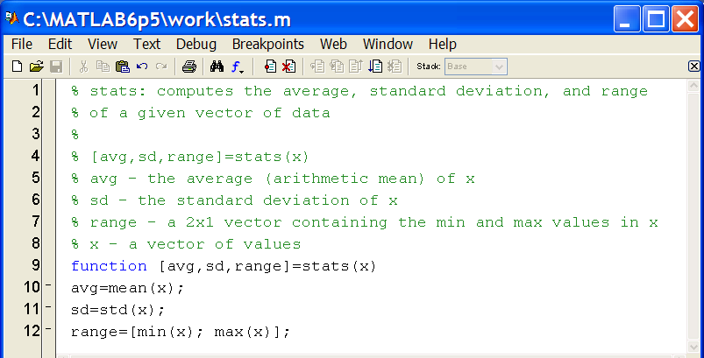
User-defined Functions
Functions look exactly like scripts, but for ONE difference
    Functions must have a function declaration
Online Help file have % comments
Function declaration
function name
Outputs
Inputs
The “meat” of the
function code

Slide 17
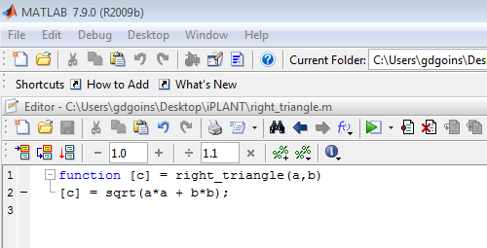
Right_Triangle Function
%This right-triangle function calculates the hypotenuse if you know the
%length of the two legs, assume a and b are the lengths of 2 sides of a
%right %triangle this Calculate the length of the other side (the
%hypotenuse, c) using the Pythagorean formula: c^2=a^2 + b^2
function c = right_triangle(a,b)
[c] = sqrt(a*a + b*b);
Notes:
Right_triangle.m

Slide 18
For Loops
All of the loop structures in matlab are started with a keyword such as "for", or "while" and they all end with the word "end".
The for loop allows us to repeat certain commands or some action in a predetermined way
The for loop is written around some set of statements, and you must tell Matlab where to start and where to end.
Basically, you give a vector in the "for" statement, and Matlab will loop through for each value in the vector:
For example, a simple loop will go around four times each time changing a loop variable, j:
>> for j=1:4
j
end
When Matlab reads the "for" statement it constructs a vector, [1:4], and j will take on each value within the vector in order. Once Matlab reads the "end" statement, it will execute and repeat the loop. Each time the for statement will update the value of j and repeat the statements within the loop. In this example it will print out the value of j each time.

Slide 19
for
for loops: use for a definite number of iterations
MATLAB syntax:
for n=1:100
commands
end
The loop variable
    Is defined as a vector
    Is a scalar within the command block
    Does not have to have consecutive values
The command block
    Anything between the for line and the end
    Can have nested loops see notes pages below
Loop variable
Command block
Notes:
% The 1:100 argument of the for loop tells MATLAB to start at 1 and loop
% until the loop variable i reaches 100. A for loop always has a loop
% variable. In this case, every time the loop is executed the value of i is
% incremented by 1. All of the commands between the for and the end
% statements are executed each pass through the
% loop. The increment of the loop does not have to
% be 1 or even be increasing.,
% Other increments besides 1
for i=1:2:10 % start at 1 and go to 10 by 2's
% Nested loops
for i=1:4
for j=1:3
disp([i j i*j])
end
end
% Note that it's the inner loop that increments the fastest (j changes
% every pass through the loop but i changes only once every time the j loop
% finishes). A final word of caution, never assign a value to the loop
% variable inside of the loop. Although doing so is somewhat innocuous in
% MATLAB, it can be really dangerous in languages such as Fortran95 or C++.
% One case where beginner programmers are tempted to do this is when they
% want to exit a for loop before the end value of the for loop has been
% reached. MATLAB (and other languages) have specific statement for doing
% this. In MATLAB the break command can be used for exiting a for loop
% before the declared ending value is actually reached. The other looping
% construct is the while loop. With this construct a series of statements
% can be executed until a specific condition is met. In the example, we'll
% add all the reciprocals of the positive integers until the current
% reciprocal is smaller than . When the current reciprocal is smaller than
% then the condition of the while statement will no longer be true and the
% while loop will terminate.

Slide 20
For Loops: example
for i = 1:10;
a(i) = i*i;
end
a
a =
1 4 9 16 25 36 49 64 81 100
All statements between the for and the end statements will be executed as per the command specifications.

